Slide 1
Description of the Information System Product and its comparison to existing systems
• Description:
A web application that can allow users to enter their usernames and generate a detailed analysis on their
GitHub behavior.
The application will make API calls to the GitHub API endpoints, extract user information on repositories,
commits, etc., and then perform calculations and further analysis based on the response received, and
display the analysis result in a visualized format to the users.
The application will automate the analysis tasks and generate new insights based on existing data,
making information more accessible for users.
• Comparison:
The existing GitHub endpoints only provide general information such as ‘listing the repositories of a user.’
However, further analysis can be performed on these information to generate deeper insights on a user.
Moreover, users need to be familiar with API technologies in order to retrieve information from the GitHub
endpoints.
This application can automate the tasks of information retrieval and make information and new insights
about GitHub users more accessible to everyone.

Slide 2
Who is the user: Recruiters looking for ideal employees in tech
Why is it important to them:
recruiter如果只有一个candidates的简历，很难evaluate这个candidate的programming skills
如果recuiter直接查看一个candidate的github profile，很难快速地得出analysis insight, 并快速地理解这个programmer的skill level
如果这个recruiter正在寻找在某些programming area，比如擅长rust的programmer，将很难通过浏览这个prorgammer的repo总结出来

Slide 3
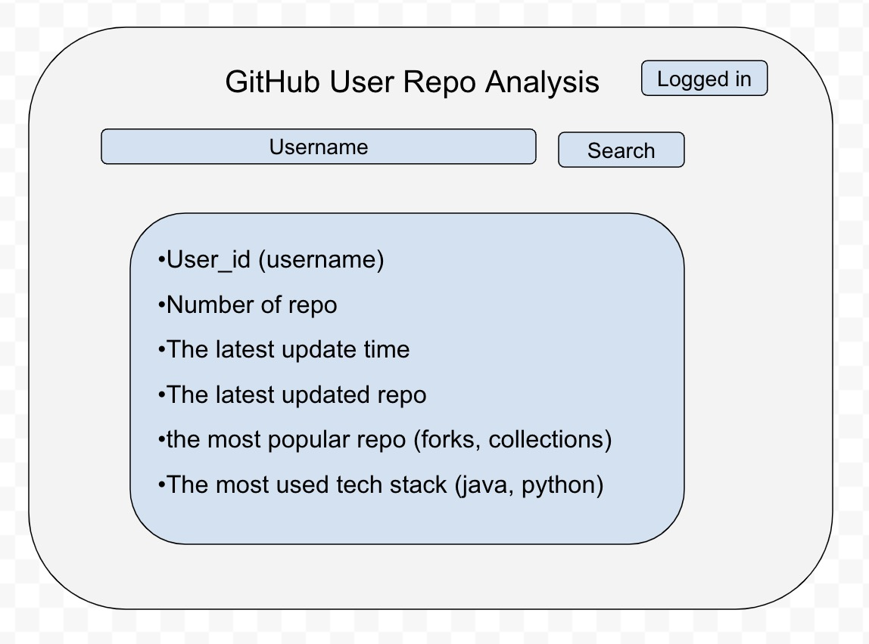
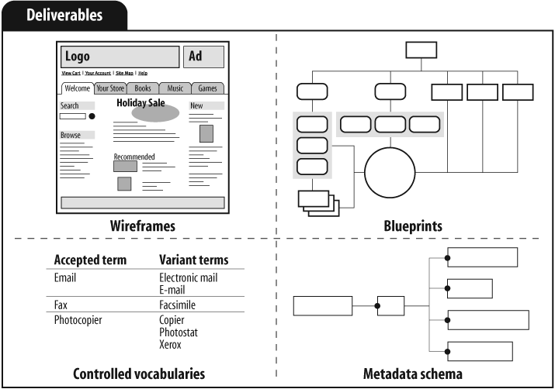
Information wireframes Slide 2: information wireframes (blueprint of how information is organization and/or UI wireframes that suggest how information is organized), and Slide 3: description of main concepts that ideally will be in the information product as either controlled vocab list or metadata scheme/taxonomy,

Slide 4
Description of main concepts
controlled vocab list

Slide 5
Basic Architecture for System
Information structure:
1. Repo information extracted from
GitHub API endpoints
e.g.
- name of the repo
- number of commits of that repo
- creation and update time of the repo
2. Repo analysis derived from
information extracted from the API
e.g.
- name of the repo
- Total popularity score of the repo
(calculated)
- Age of repository (calculated)
Hosting:
Localhost/Cloud hosting/Netlify
Technologies:
Frontend:
React & TypeScript, Material UI
Backend (if needed):
Java & SpringBoot / Python &
Flask

